Slide 1
Traditional Advanced Control Strategies

Slide 2
Traditional Advanced Control Strategies
High level application of PID controller
Time delay Compensator
Cascade Control
Split range Control
Feedforward and Ratio Control
Selective control
Override Control
Valve Position Control
Variable Structure Control

Slide 3
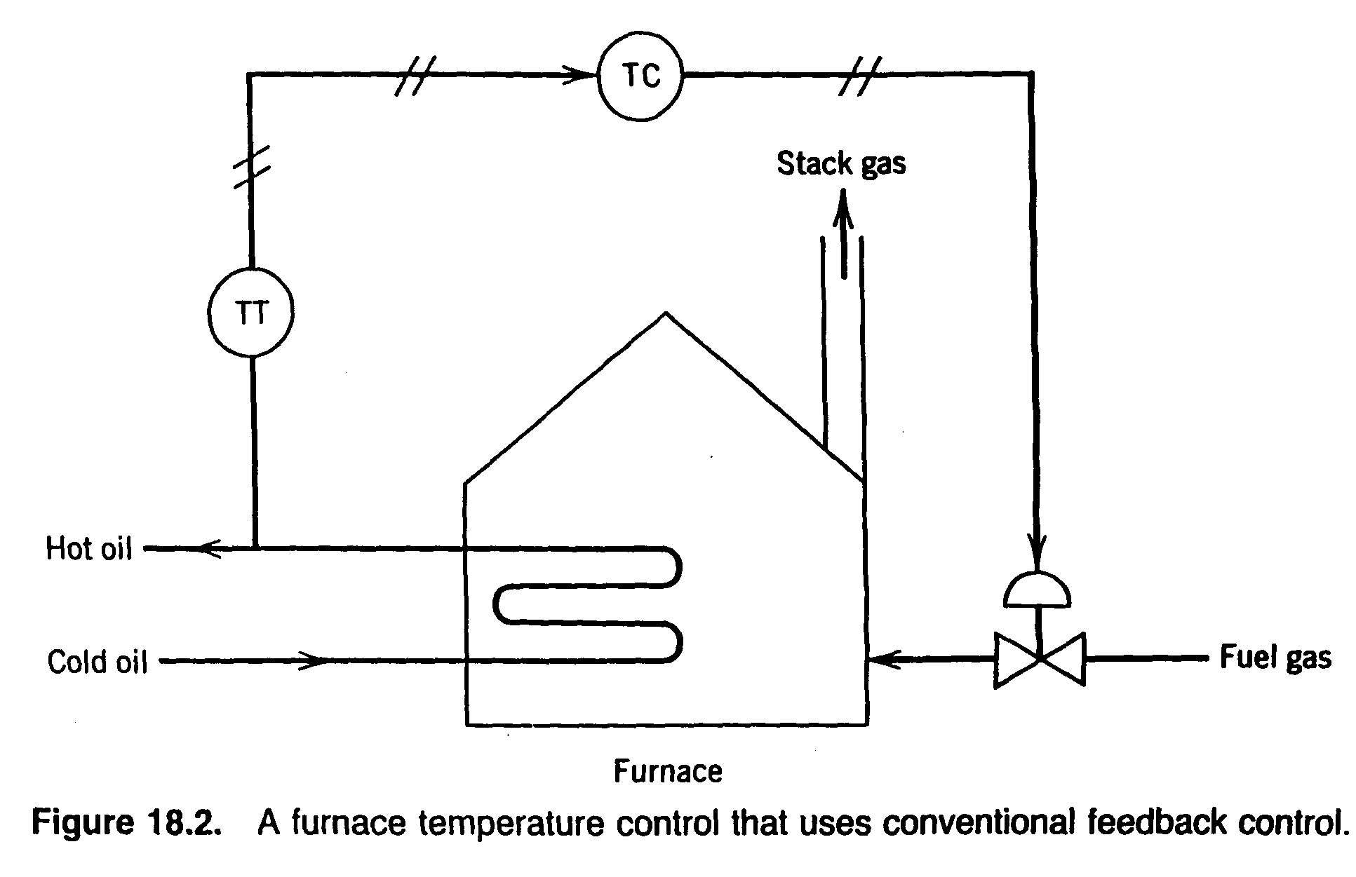
Cascade Control
Hot oil Temperature is controlled by fuel gas flow rate
Fuel gas obtained from other process units and so pressure of the fuel gas fluctuates
Flow rate of fuel gas will be different for the same valve opening

Slide 4
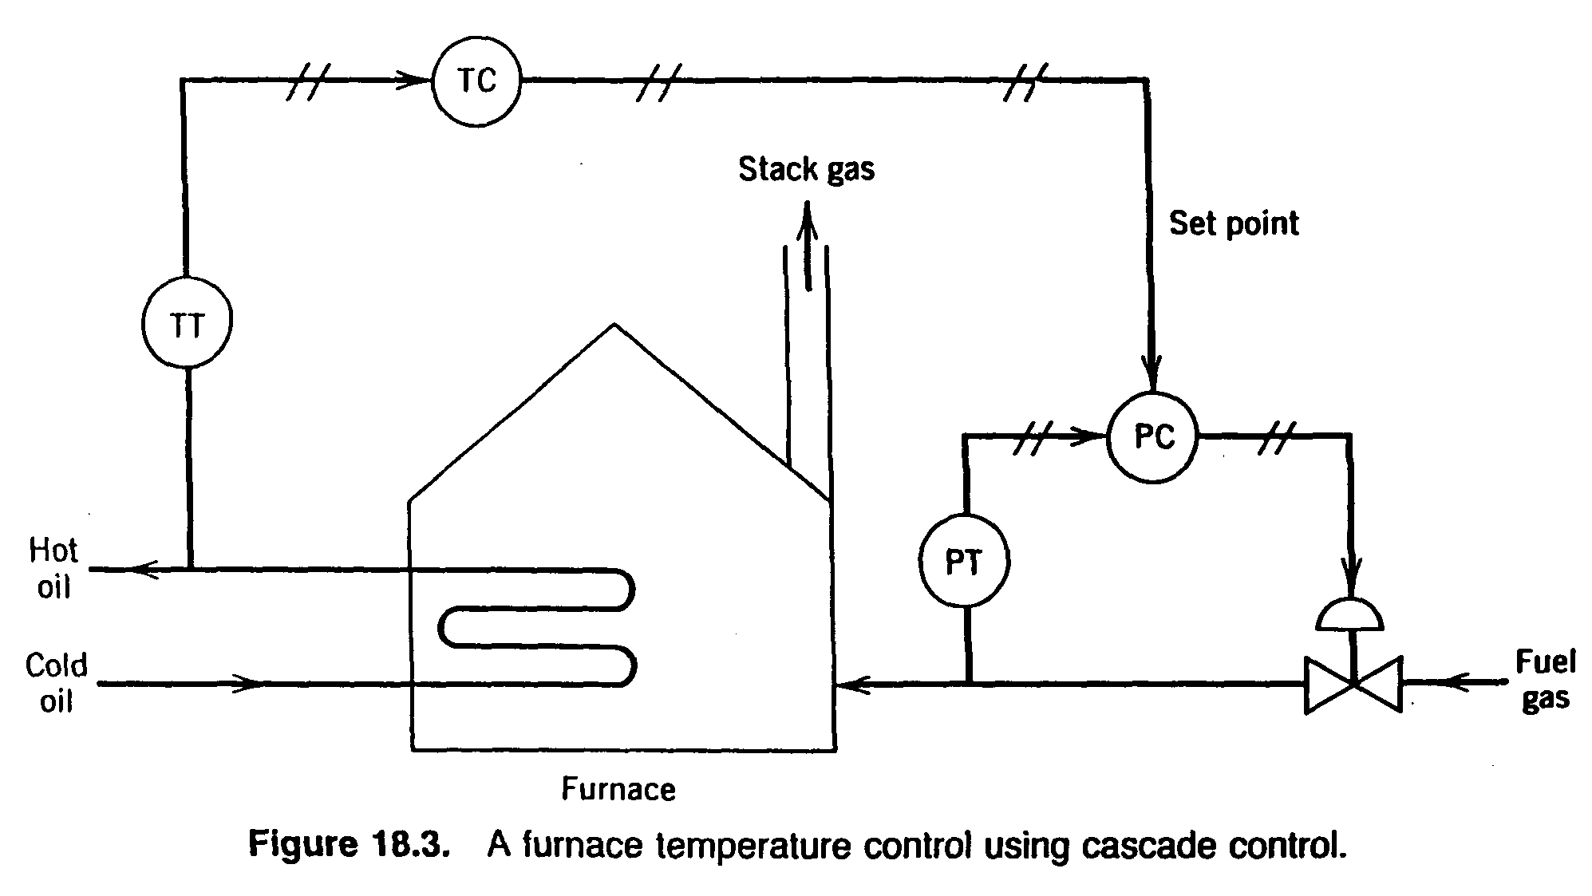
Cascade Control
Maintain fuel gas pressure / flow regardless of header pressure and valve characteristics
Two FB controllers but only a single control valve (or other -final control element).
Output signal of the "master" controller is the set point for “slave" controller.
Two FB control loops are "nested" with the "slave" (or "secondary") control loop inside the "master" (or "primary") control loop.

Slide 5
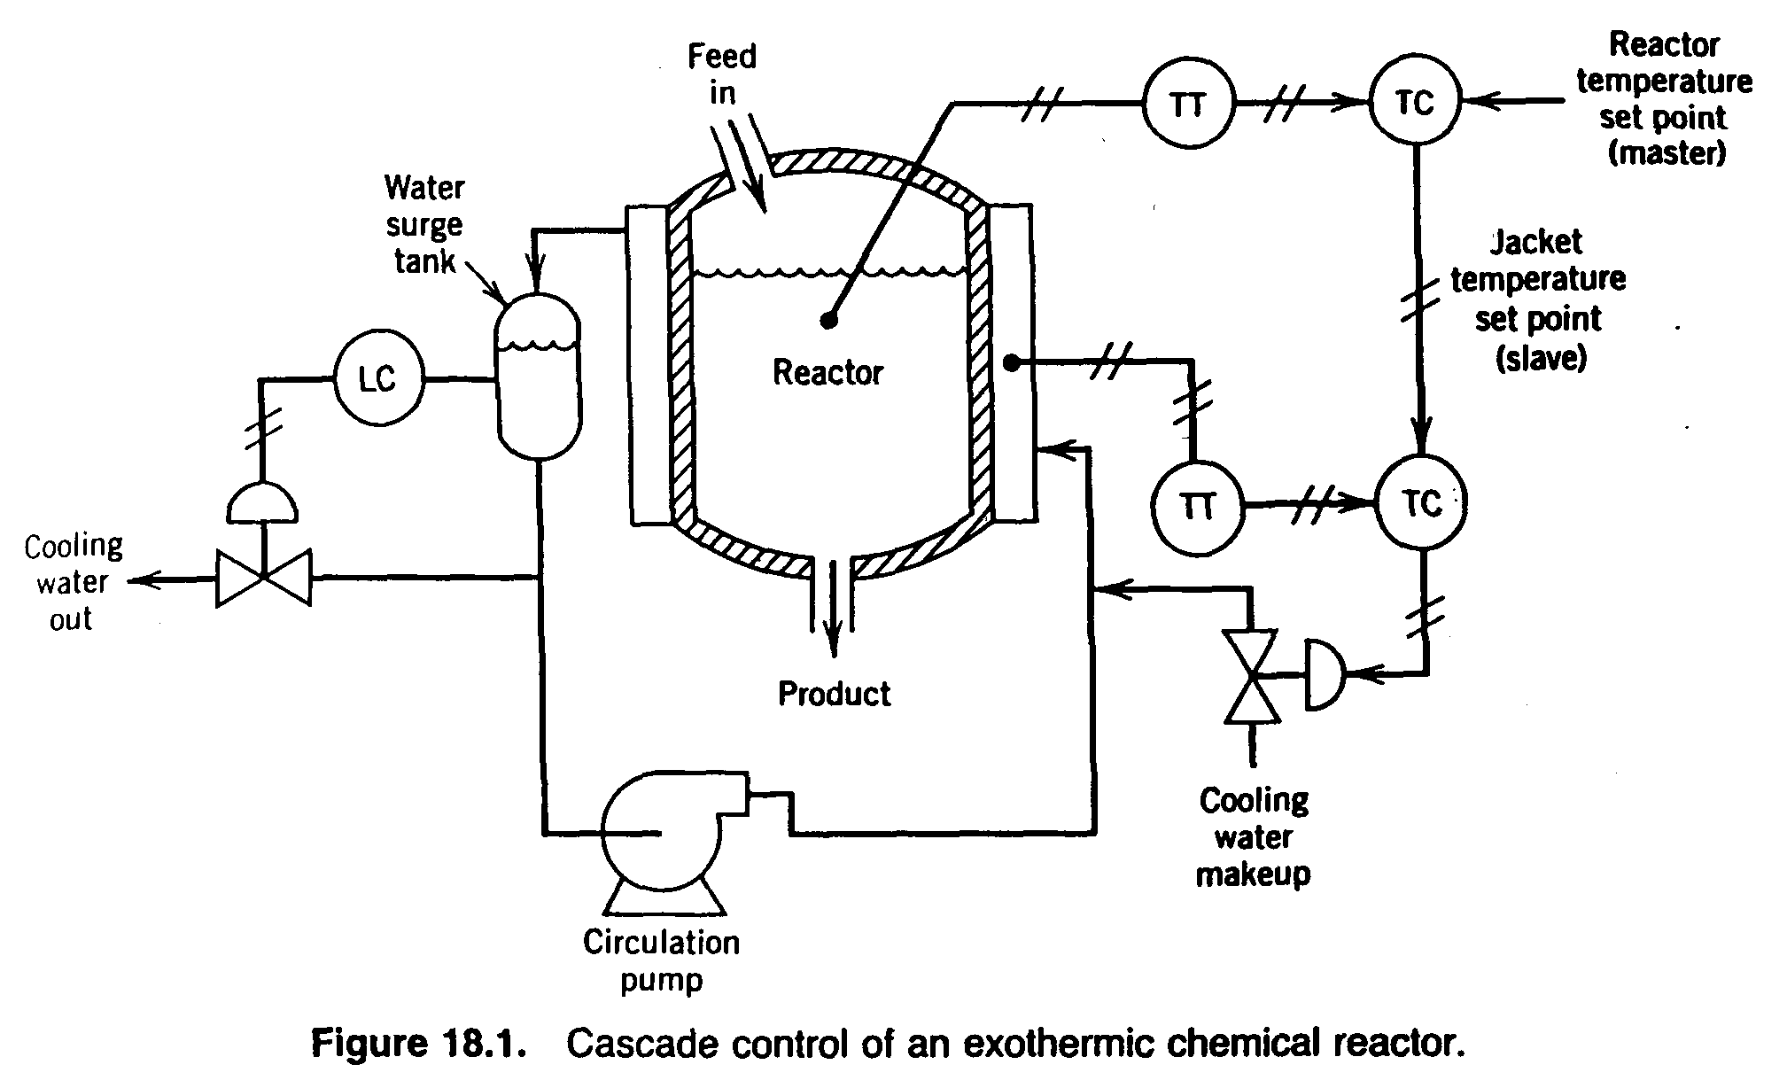
Cascade Control
Jacket Temperature can be controlled by adjusting cooling water flow rate
If the cooling water inlet temperature changes, the jacket temperature will change with same flow rate
For rise in Reactor temperature, hot CW will be replaced by cold CW

Slide 6





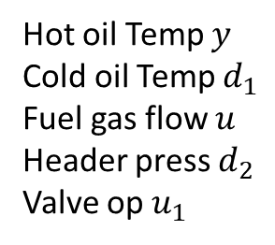


Cascade Control : Block Diagram
Hot oil Temp $y$
Cold oil Temp $d_{1}$
Fuel gas flow $u$
Header press $d_{2}$
Valve op $u_{1}$
$$d_{2}(s)$$
$$d_{1}(s)$$
$$y_{sp}$$
$$u_{sp}$$
$$u_{1}$$
$$u$$
+
$$y$$
+
C(s)
+
P(s)
+
C(s)
+
C2(s)
+
-
C1(s)
-
V(s)

Slide 7




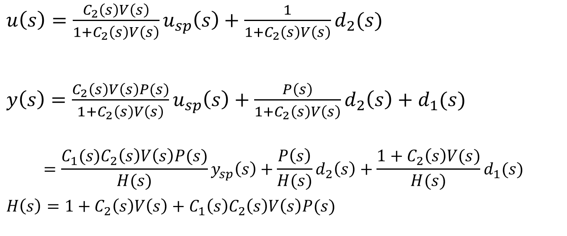


Cascade Control : Feedback Equation
$$d_{2}(s)$$
$$d_{1}(s)$$
$$y_{sp}$$
$$u_{sp}$$
$$u_{1}$$
u
+
$$y$$
+
C(s)
+
P(s)
+
C(s)
+
C2(s)
+
-
C1(s)
-
V(s)
$u\left(s\right)=\frac{C_{2}\left(s\right)V\left(s\right)}{1+C_{2}\left(s\right)V\left(s\right)}u_{sp}\left(s\right)+\frac{1}{1+C_{2}\left(s\right)V\left(s\right)}d_{2}(s)$
$y\left(s\right)=\frac{C_{2}\left(s\right)V\left(s\right)P(s)}{1+C_{2}\left(s\right)V\left(s\right)}u_{sp}\left(s\right)+\frac{P\left(s\right)}{1+C_{2}\left(s\right)V\left(s\right)}d_{2}\left(s\right)+d_{1}(s)$
$$=\frac{C_{1}(s)C_{2}\left(s\right)V\left(s\right)P(s)}{H(s)}y_{sp}\left(s\right)+\frac{P\left(s\right)}{H(s)}d_{2}\left(s\right)+{\frac{1+C_{2}\left(s\right)V(s)}{H(s)}d}_{1}(s)$$
$H\left(s\right)=1+C_{2}\left(s\right)V\left(s\right)+{C_{1}\left(s\right)C}_{2}\left(s\right)V\left(s\right)P(s)$

Slide 8
Cascade Control
Advantages
Reject the disturbance in the slave loop before it affects the main process variables.
Linearize the slave process
Improve the dynamics of the slave process
Implementation
The slave process is at least 3 times as faster as master loop in terms of response time.
The slave loop may not need to be controlled exactly at set point. (I- mode is not necessary in many cases.) It needs to be controlled to provide fast action on disturbance and set point change. (P-mode may be suffice in most cases.)
The slave loop should be tuned first while the master in manual. Then tune the master while the slave is in automatic mode.
If the slave is retuned for some reasons, the master should be retuned.
The master can be transferred to ‘auto’ after the slave becomes ‘auto’.

Slide 9
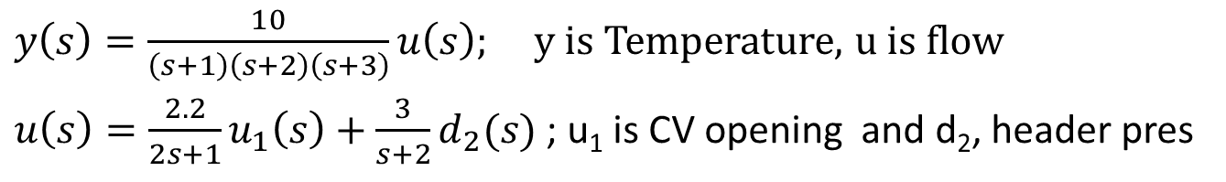
Furnace Control : Matlab Implementation
$y\left(s\right)=\frac{10}{\left(s+1\right)\left(s+2\right)\left(s+3\right)}u\left(s\right);$y is Temperature, u is flow
$u\left(s\right)=\frac{2.2}{2s+1}u_{1}\left(s\right)+\frac{3}{s+2}d_{2}(s)$ ; u₁ is CV opening and d₂, header pres
s=tf('s');
P=10/(s+1)/(s+2)/(s+3);
V=2.2/(2*s+1);
VD=3/(s+2);
% Tune PI controller for target
%bandwidth is 0.2 rad/s and
%phase Margin 60
C = pidtune(P*V,pidstd(1,1),0.2);
sys1 = feedback(P*V*C,1);
sys1.Name = 'Single Loop';
% target bandwidth 2 rad/s and
% phase margin 60 for Inner controller
C2 = pidtune(V,pidstd(1,1),2);
clsys = feedback(V*C2,1);
sys2 = feedback(clsys*P*C,1);
sys2.Name = 'Cascade';
figure;
step(sys1,'r',sys2,'b')
legend('show','location','southeast')
title('Reference Tracking')
% Disturbance rejection
sys1d1 = feedback(P,V*C);
sys1d1.Name = 'Single Loop';
sys2d1 = P*VD/(1+V*C2+V*P*C*C2);
sys2d1.Name = 'Cascade';
figure;
step(sys1d1,'r',sys2d1,'b')
legend('show')
title('Disturbance Rejection')

Slide 10
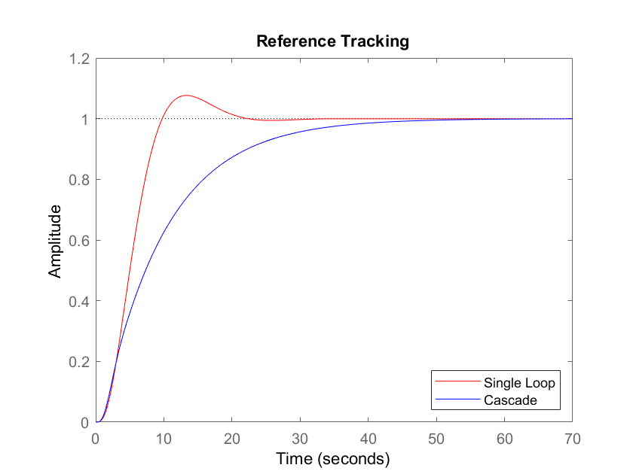

Slide 11
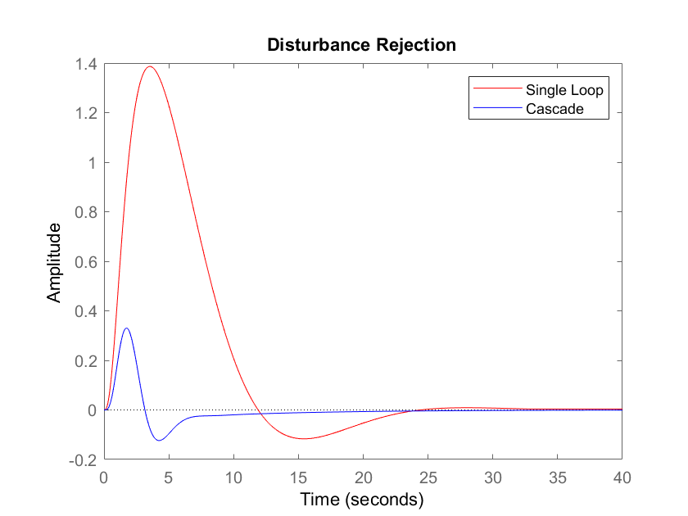

Slide 12
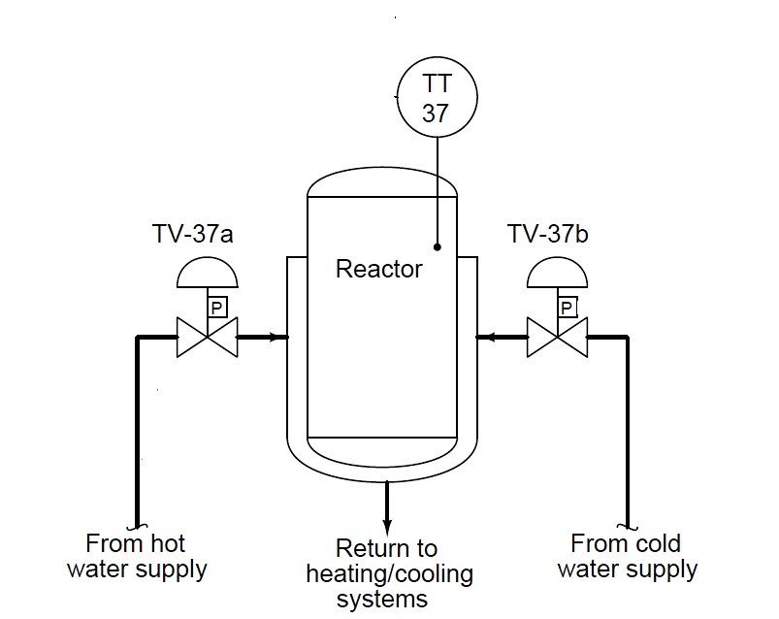
Split Range Control
Control of Batch Reactor
Ensures maximum production of desired product
Suppress the production of undesired product
Desired temperature should Rise at 5⁰C per min upto certain time and then decrease at the same rate
What should be the control strategy ??

Slide 13
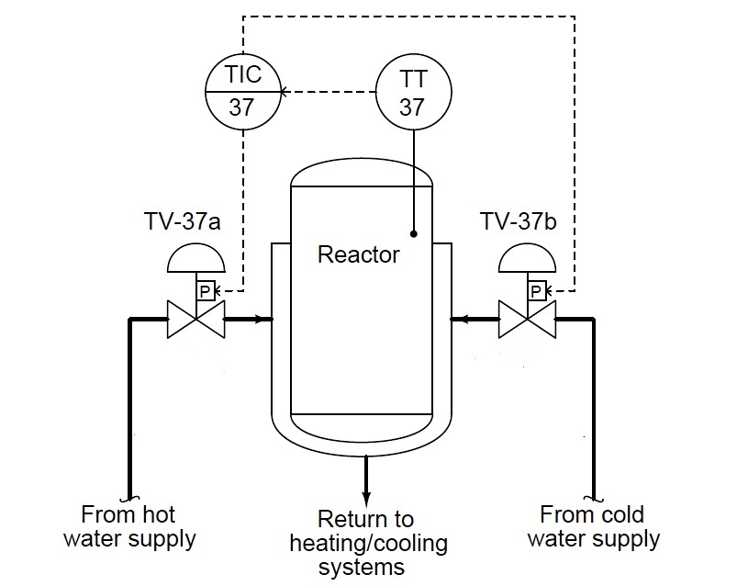
Split Range Control
Control of Batch Reactor
Feedback control of reactor temperature
Controller output sent to both control valves
How the control valves will operate based on same controller signal?

Slide 14
Split Range Control
Split Range Control Loop is used, where there are several manipulated variables, but a single output variable.
The coordination among different manipulated variables is carried out by using Split Range Control.
The split range control loop can be implemented in three different ways.
Split Range Control
Sequence Control
Opposite Action Control

Slide 15
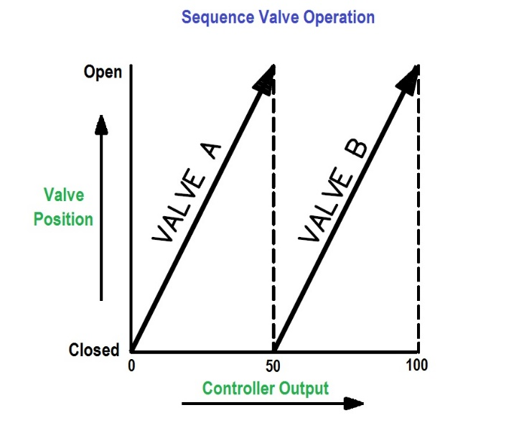
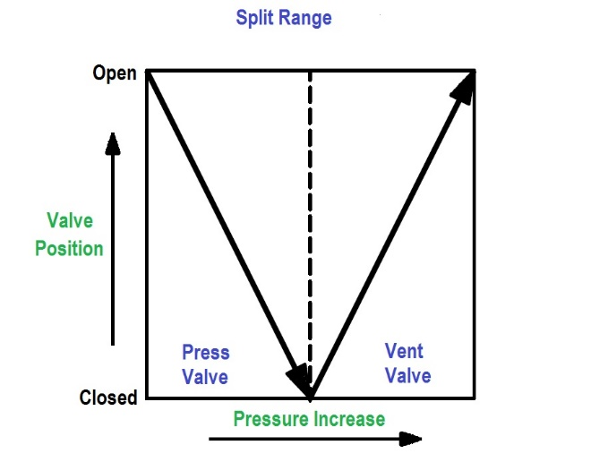
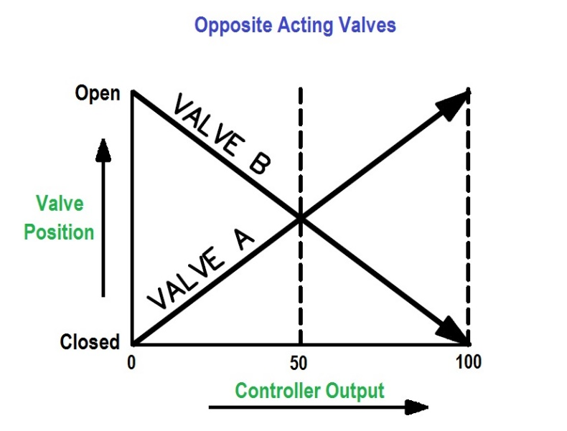
Split Range Control
Split Range
Sequence Operation
A
B
Opposite Action

Slide 16
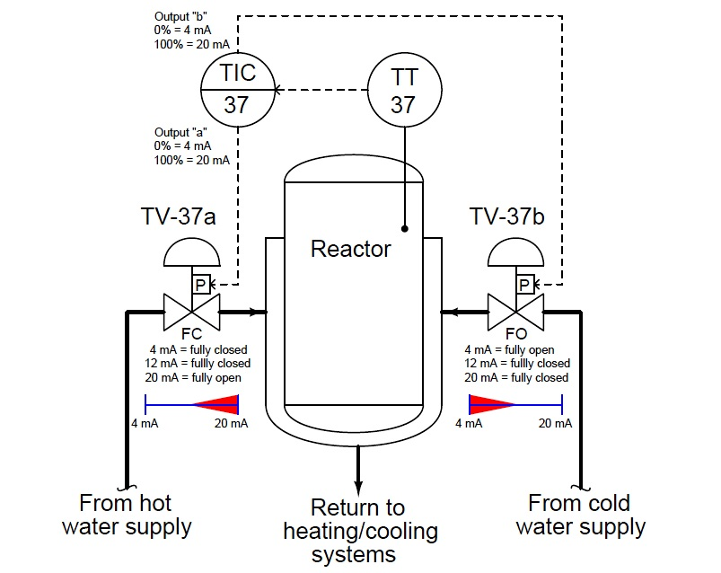
Split Range Control
Control of Batch Reactor
Controller output (range 4-20 mA) sent to both control valves
As temperature increases, controller output decreases.
Cold water supply should increase.
Hot water supply should decrease
Cold side CV work between 4 to 12 mA
Hot side CV work between 12 to 20 mA

Slide 17
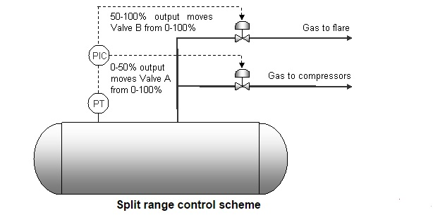
Split Range Control
Control of overhead drum in a separator
For normal operation, gas is sent to header
Gas is sent to flare when drum pressure increases above normal operating range

Slide 18
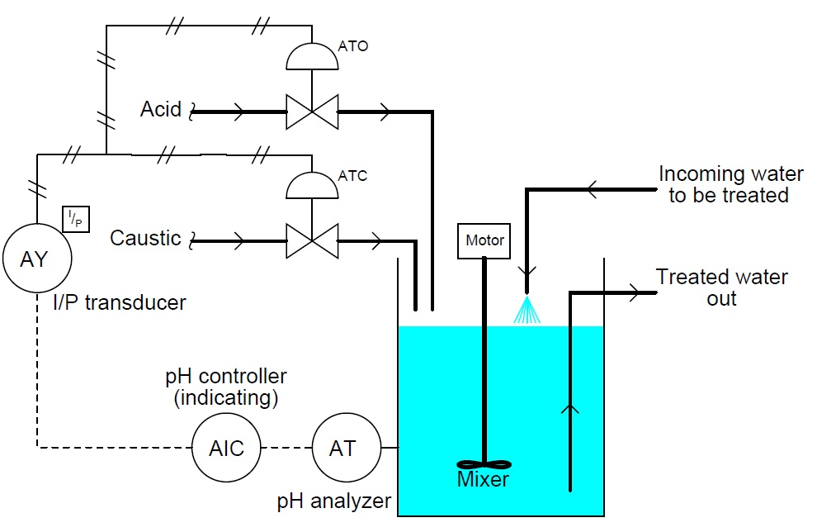
Split Range Control
Control of pH neutralization reactor

Slide 19
Feedforward & Ratio Control

Slide 20
Feedback Control
Advantages of Feedback Control
Corrective action occurs as soon as the controlled variable deviates from the set point, regardless of the source and type of disturbance.
Feedback control requires minimal knowledge about the process to be controlled; in particular, a mathematical model of the process is not required, although it can be very useful for control system design.
PID controller is both versatile and robust. If process conditions change, retuning the controller usually produces satisfactory control.

Slide 21
Feedback Control
Disadvantages of Feedback Control
Corrective action is taken only after a deviation in the controlled variable occurs. Thus, perfect control, where the controlled variable does not deviate from the set point during disturbance or set-point changes, is theoretically impossible.
Feedback control does not provide predictive control action to compensate for the effects of known or measurable disturbances.
It may not be satisfactory for processes with large time constants and/or long time delays. If large and frequent disturbances occur, the process may operate continuously in a transient state and never attain the desired steady state.
In some situations, the controlled variable cannot be measured on-line, and, consequently, feedback control is not feasible.

Slide 22
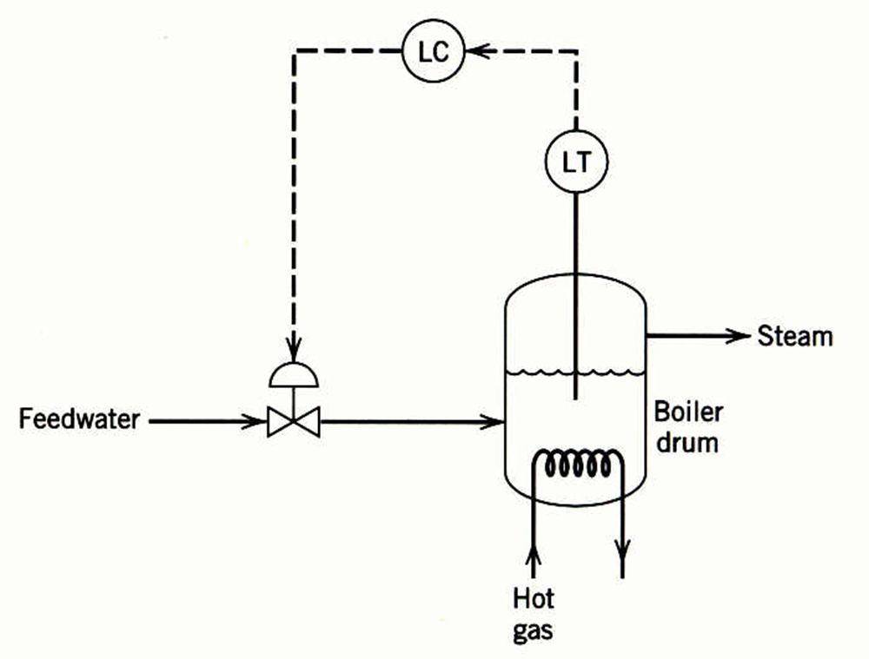
FeedForward Control
The basic concept of feedforward control is to measure important disturbance variables and take corrective action before they upset the process.
Rapid disturbance changes can occur as a result of steam demands made by downstream processing units.
This control system tends to be quite sensitive to rapid changes in the disturbance variable, steam flow rate, as a result of the small liquid capacity of the boiler drum.

Slide 23
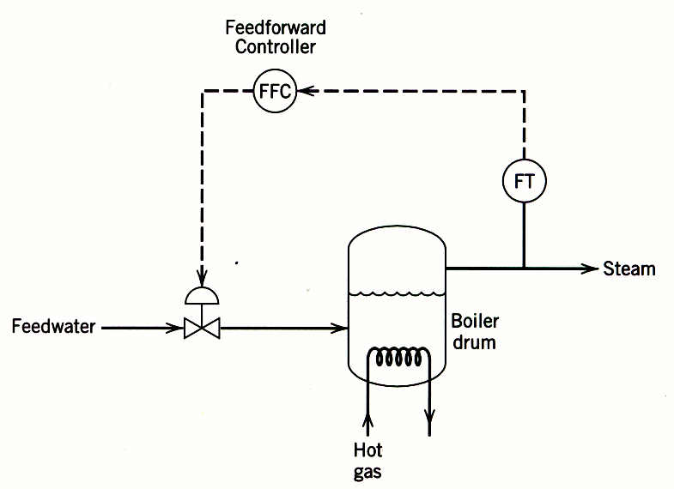
Feedforward Control
The feedforward control scheme can provide better control of the liquid level. Here the steam flow rate is measured, and the feedforward controller adjusts the feed water flow rate.

Slide 24
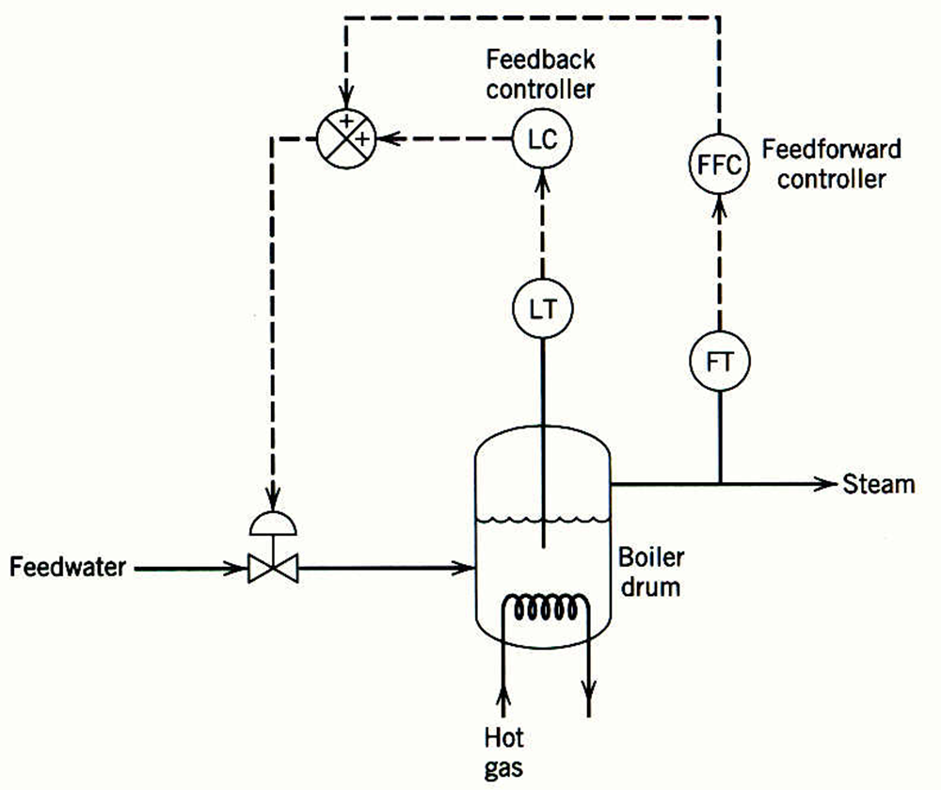
Feedforward-Feedback Control
In practical applications, feedforward control is normally used in combination with feedback control.
Feedforward control is used to reduce the effects of measurable disturbances, while feedback trim compensates for inaccuracies in the process model, measurement error, and unmeasured disturbances.

Slide 25
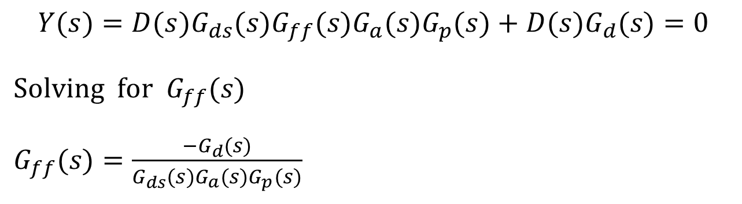
Derivation of FF Controller
$$Y(s)=D(s)G_{ds}(s)G_{ff}(s)G_{a}(s)G_{p}(s)+D(s)G_{d}(s)=0$$
$\text{Solving} \text{for} G_{ff}(s)$
$G_{ff}(s)=\frac{−G_{d}(s)}{G_{ds}(s)G_{a}(s)G_{p}(s)}$

Slide 26
Lead/Lag Element for Implementing FF Control

Slide 27
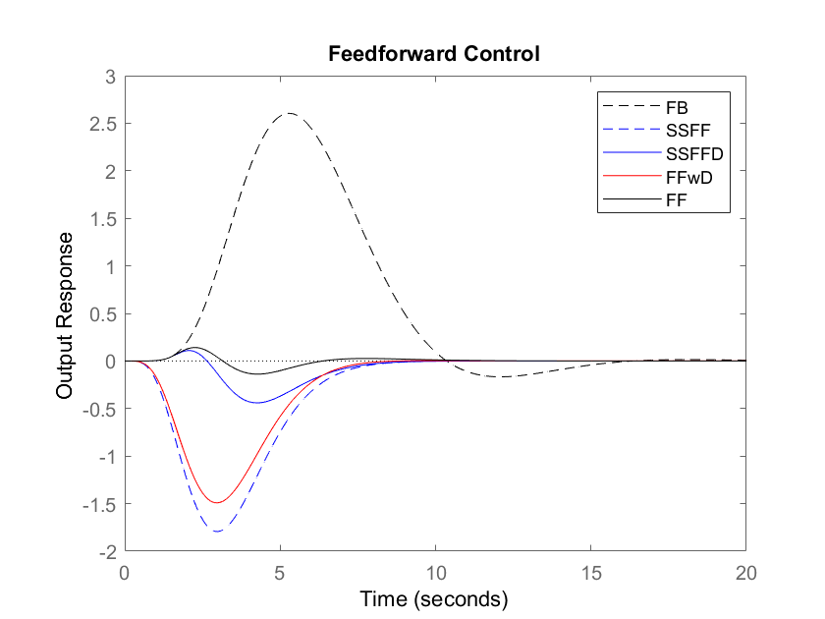

Feedforward Control
SSFF → $K_{ff}$ SSFFD → $K_{ff}e^{−θ_{ff}s}$
FFwD → $K_{ff}\frac{τ_{ld}s+1}{τ_{lg}s+1}$
FF = $K_{ff}\frac{τ_{ld}s+1}{τ_{lg}s+1}e^{−θ_{ff}s}$

Slide 28
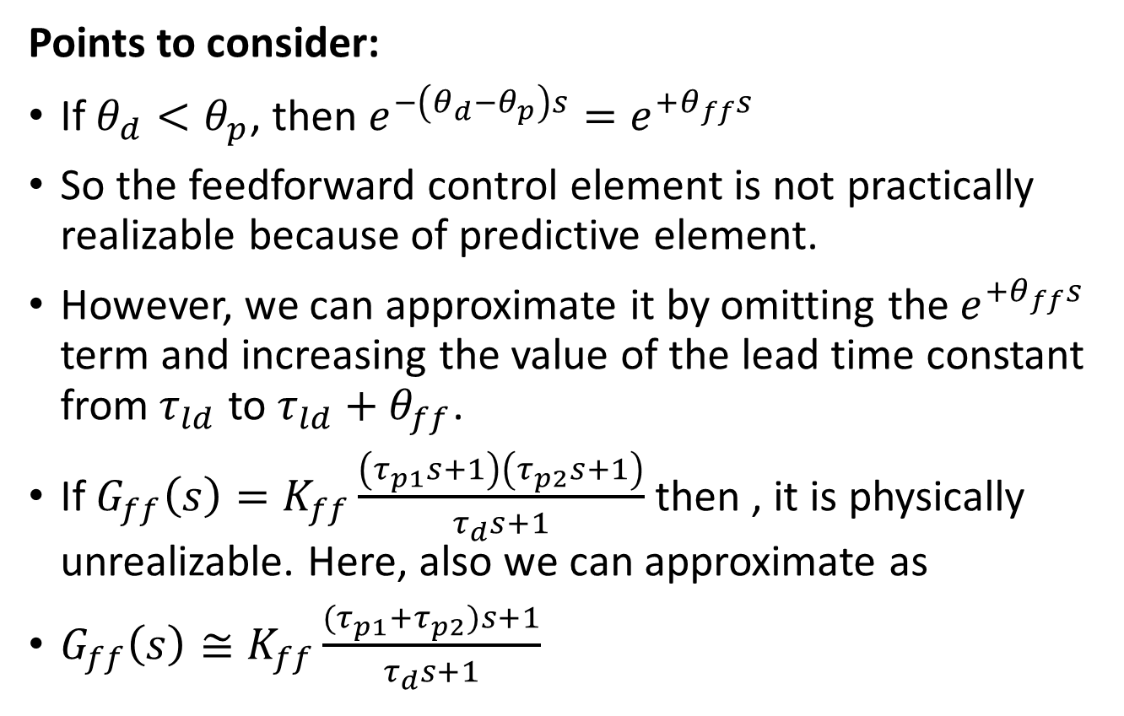
Feedforward Control
Points to consider:
If $θ_{d}<θ_{p}$, then $e^{−\left(θ_{d}−θ_{p}\right)s}=e^{+θ_{ff}s}$
So the feedforward control element is not practically realizable because of predictive element.
However, we can approximate it by omitting the${ e}^{+θ_{ff}s}$ term and increasing the value of the lead time constant from$τ_{ld}$ to $τ_{ld}+θ_{ff}$.
If $G_{ff}\left(s\right)=K_{ff}\frac{\left(τ_{p1}s+1\right)\left(τ_{p2}s+1\right)}{τ_{d}s+1}$ then , it is physically unrealizable. Here, also we can approximate as
$G_{ff}\left(s\right)≅K_{ff}\frac{{(τ}_{p1}+τ_{p2})s+1}{τ_{d}s+1}$

Slide 29
Combined FF and FB Control
feedback trim compensates for inaccuracies in the process model, measurement error, and unmeasured disturbances.
Stability of the feedback loop is not altered by the Feedforward Controller

Slide 30
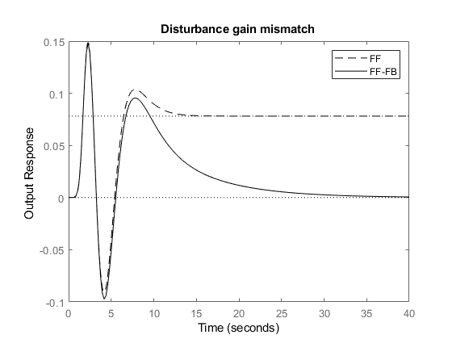
Combined FF and FB Control

Slide 31
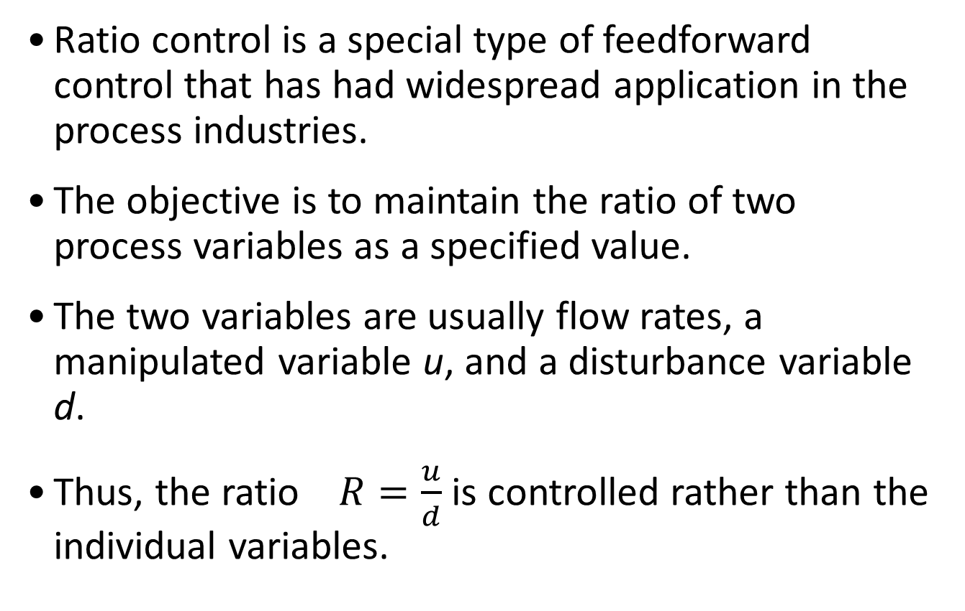
Ratio Control
Ratio control is a special type of feedforward control that has had widespread application in the process industries.
The objective is to maintain the ratio of two process variables as a specified value.
The two variables are usually flow rates, a manipulated variable u, and a disturbance variable d.
Thus, the ratio $R=\frac{u}{d}$ is controlled rather than the individual variables.

Slide 32
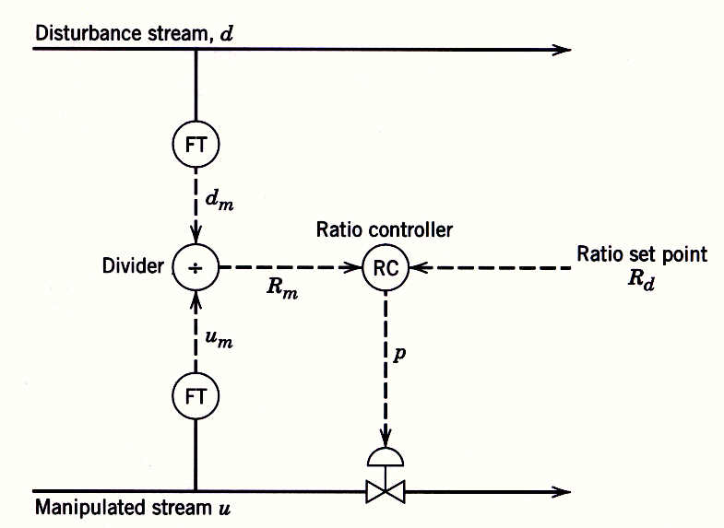
Typical applications of ratio control
Setting the relative amounts of components in blending operations
Advantage
Actual ratio R is calculated.
Disadvantage
Divider element must be included in the loop, and this element makes the process gain vary in a nonlinear fashion.

Slide 33
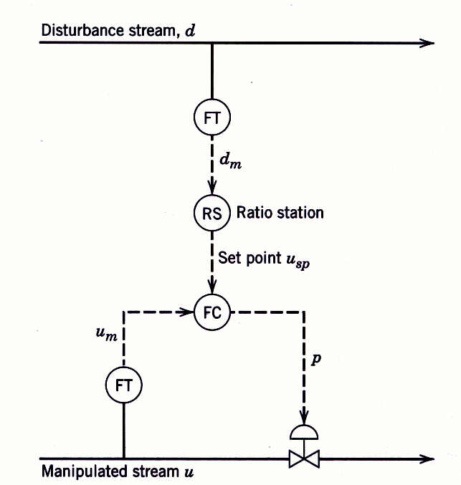
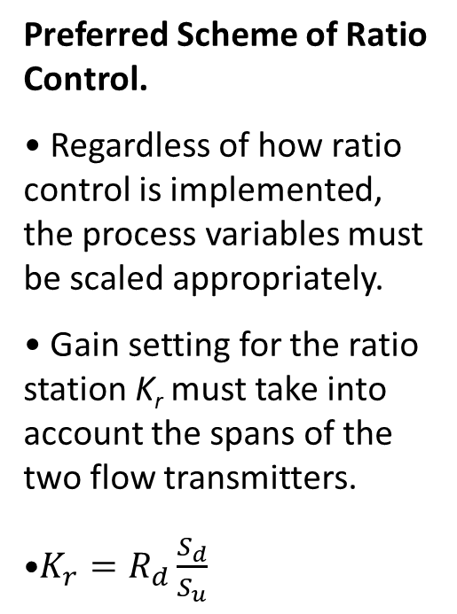
Typical applications of ratio control
Preferred Scheme of Ratio Control.
Regardless of how ratio control is implemented, the process variables must be scaled appropriately.
Gain setting for the ratio station K_{r} must take into account the spans of the two flow transmitters.
$K_{r}=R_{d}\frac{S_{d}}{S_{u}}$

Slide 34
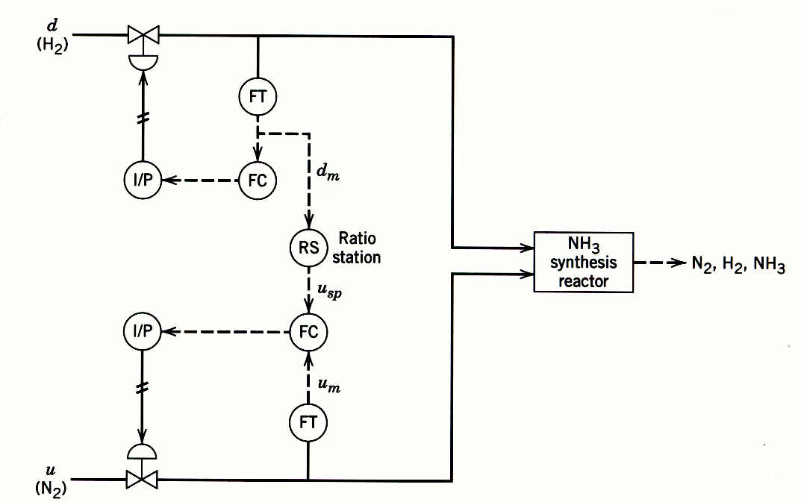
Typical applications of ratio control
Maintaining a stoichiometric ratio of reactants to a reactor
0-30 l/m
Gain = ?
0-15 l/m

Slide 35
Ratio Control for Wastewater Neutralization
The output of the pH controller is the ratio of NaOH flow rate to acid wastewater flow rate; therefore, the product of the controller output and the measured acid wastewater flow rate become the setpoint for the flow controller of the NaOH addition.

Slide 36
Ratio Control Requiring Dynamic Compensation

Slide 37
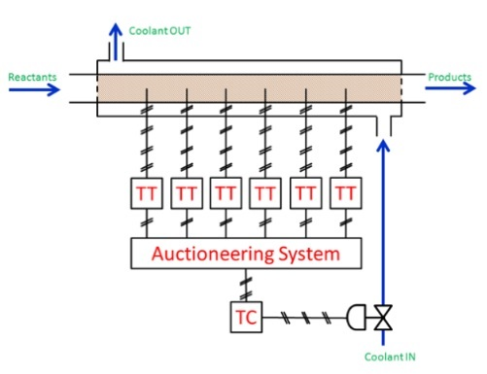
Auctioneering Control
Control of Tubular reactor
More than one measurements
One manipulated variable
Selection of appropriate output from multiple measurements
Low Selector (LS), High Selector(HS or Median Selector( MS) is used
Hotspot Temperature control
Location of hotspot travels
Difficult to pinpoint location of hotspot
Use multiple temperature sensors
HS selects the highest temperature

Slide 38
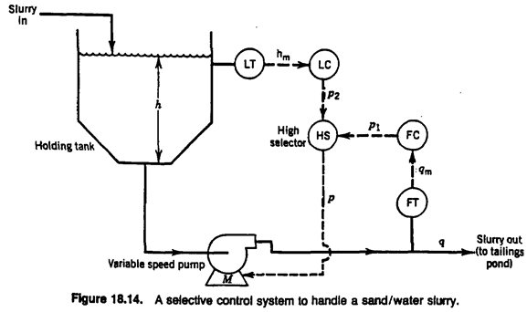
Override/Select Controls
Process are many times operated at the safety or equipment limits in order to maximize process throughput.
During upset periods, it is essential that safety limits are enforced.
Objective:
Regulate level and exit flow rate of sand water slurry
Slurry velocity in the exit line must be above lower limit
Normal : LC is operating
Too Low Flow: FC overtakes

Slide 39
Furnace Tube Temperature Constraint Control
Under normal operation, the controller adjusts the furnace firing rate to maintain process stream at the setpoint temperature.
At higher fuel rates, excessive tube temperatures can result greatly reducing the useful life of the furnace tubes.
The LS switch reduces the firing rate to ensure that the furnace tubes are not damaged.

Slide 40
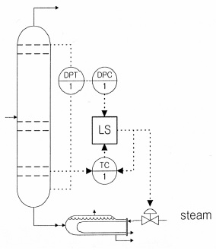
Column Flooding Constraint Control
Objectives:
Maintain the temperature at set point (composition control)
Maintain ΔP < ΔP_{max} (preventing flooding)
Normal: temperature controller is working
If ΔP is too high, the differential pressure (DP) controller takes over and reduce the steam flow set point.
Temp. controller: PI controller
DP controller: not tightly tuned
P control with flooding limit of DP

Slide 41
Controlling Multiple Constraints

Slide 42
Cross-Limiting Firing Controls
It is critical that excess oxygen is maintained during firing rate increases or decreases or CO will form.

Slide 43
Cross-Limiting Firing Controls
It is critical that excess oxygen is maintained during firing rate increases or decreases or CO will form.
When the firing rate is increased, the air flow rate will lead the fuel flow rate.

Slide 44
Cross-Limiting Firing Controls
It is critical that excess oxygen is maintained during firing rate increases or decreases or CO will form.
When the firing rate is decreased, the fuel flow rate will lead the air flow rate.

Slide 45
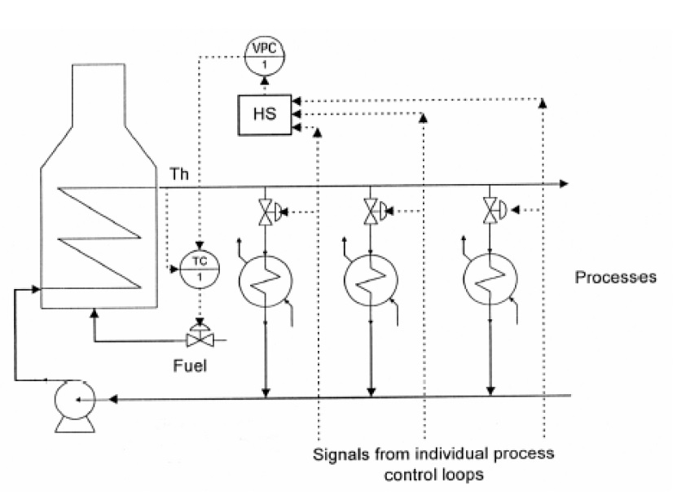
Valve Position Control
Objectives:
• Supply energy to downstream processes as they require
• Minimize the energy consumption of heater
Heater outlet controller:
maintain the temp of the heater as it directed for enough supply of energy to down stream processes
Valve position controller:
• Adjust the TC set point
so that the valve opening
of at least one of the valves
is near “fully open”.
(slow control)
• I-control can be used.
(slow but no offset)
• The SP should be around
90-95% (fully open).

Slide 46
Mixing Tank Cooling Control
Objectives:
• Remove the heat of mixing and maintain mixture temperature
• Maximize the production of mixed feed
Cascaded jacketed tank temp controller: maintain the temp of the mixture by removal of heat of mixing using cooling water
Valve position controller:
• Increase the feed flow of A while cooling capacity allows. (slow control)
• Mix ratio is maintained by
ratio control scheme
• The SP should be around
90-95% (fully open).

Slide 47
Floating pressure of distillation column
Objectives:
Maintain the column pressure by adjusting reflux flow rate
If the level is too low (below the heat transfer area), the vent must be open to relieve the column pressure.
Pressure Controller: control the P by adjusting reflux flow rate.
Level controller: takes over if level is too low. (L<Lmin)
If LC takes over, there is a discrepancy, and it opens the vent valve.
The K in summing station decides the vent opening.

Slide 48
Blending Process Control
Objectives:
Maintain product composition
Maximize production
The additive flow rates are limited (constrained)
Control scheme:
Override control for max production
Ratio control for composition
Valve position control for additive flow constraint

